Slide 1


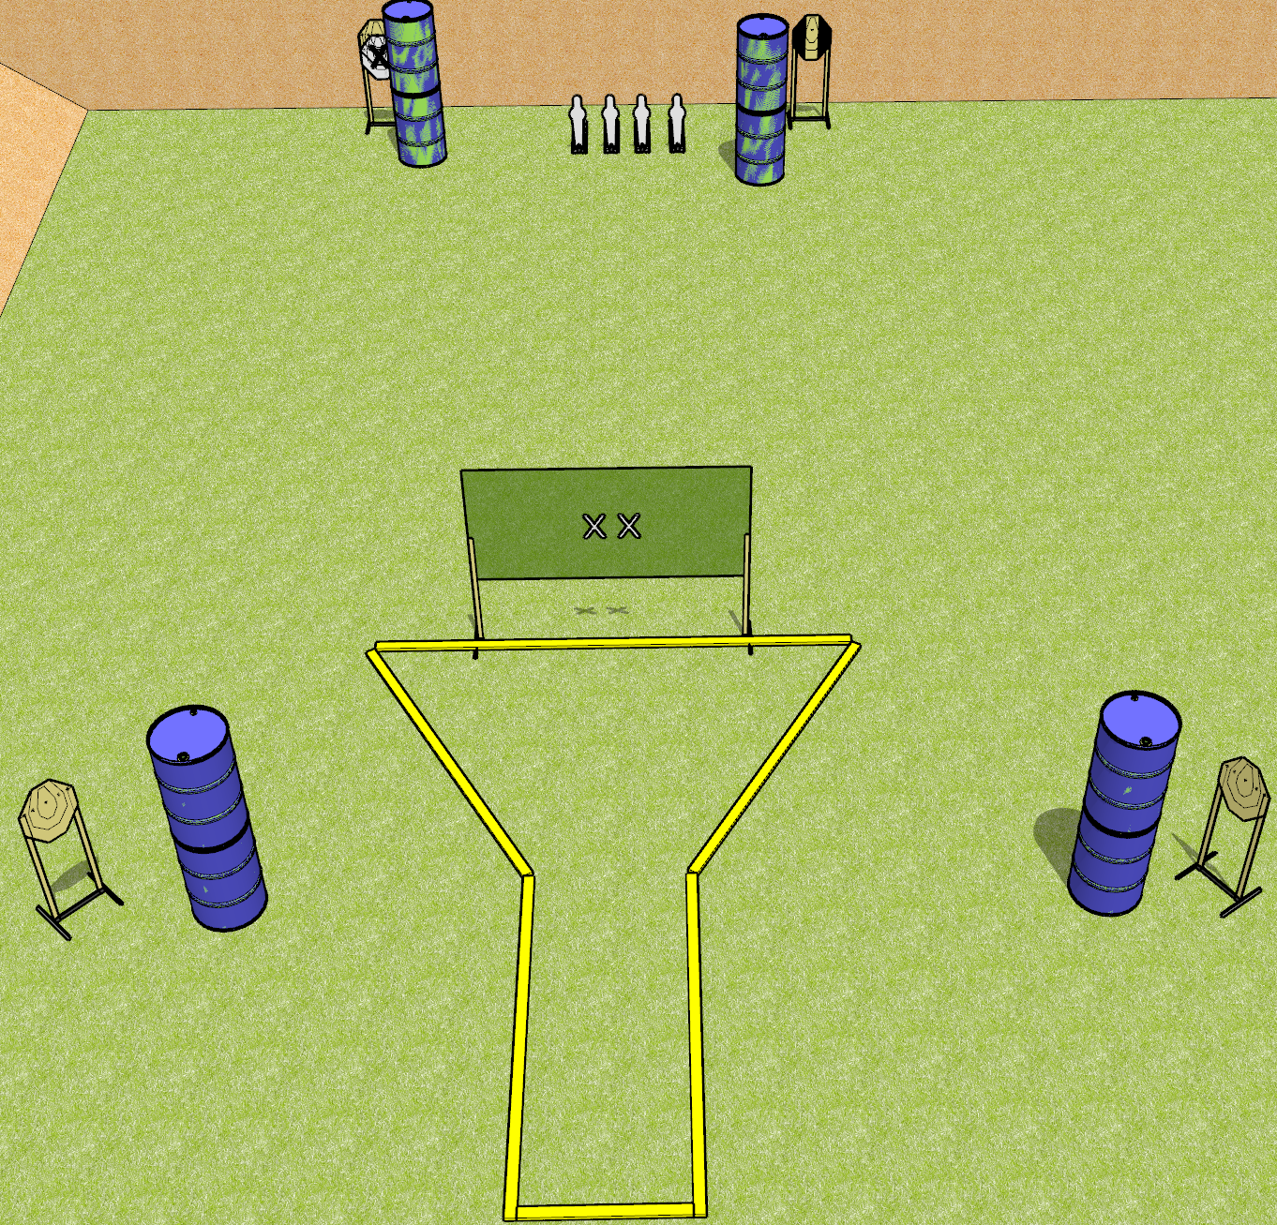
 | Dothan Gun Club – USPSA Match Four Turtles Course Designer : Drew Coleman
Round Count 20 4 IPSC Targets 4 USPSA Mini poppers
Equipment List 2 wall feet

Slide 2
Four Turtles
Written Stage Briefing
Four Turtles is a 100 point, Comstock medium course. There are 4 IPSC targets and 4 USPSA mini poppers. The best 4 hits on paper will score, and steel must fall to score. The start signal is audible.
Handgun start position is both hands on X’s. Handgun is loaded and holstered.
PCC start position is muzzle touching either X. Loaded carbine is held with both hands, shouldered, safety on.
On start signal, engage targets as they become available from within the shooting area.

